Slide 1
Wi-Fi Traffic Monitoring System

Slide 2
Wi-Fi Traffic Monitoring System
github page
https://github.com/network-2025/Lab2-Wi-Fi_Traffic_Monitoring

Slide 3
Understand the fundamental principles of local Wi-fi network traffic
Learn a practical method for capturing and analyzing data packets
Explore how traffic monitoring can be used for performance analysis, security, and general network insights
Introduction
Lab setup
Dashboard and observation
Advance suggestions

Slide 4
Introduction
- Wi-Fi Traffic Monitoring -

Slide 5
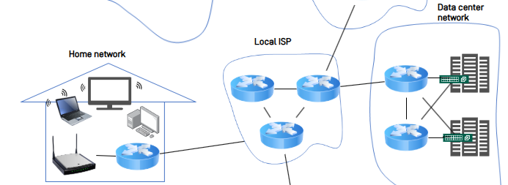
What is Wi-Fi Traffic and Why Monitor it?
What is Wi-Fi Traffic?
The flow of data packets between your devices and the router.
It's the invisible conversation happening on your network.
Why monitor it?
Security: Detect threats & unauthorized devices.
Performance: Find bottlenecks & manage bandwidth.
Troubleshooting: Diagnose connection issues.
source
Provided by instructor

Slide 6
What is a packet? Anatomy of a Data Packet
Every piece of data is sent in a packet, which is like a digital envelop. Each packet has three main parts:
Header (The “Mailing Label”)
Contains all the control information for delivery.
Source & Destination Addresses / Protocol / Port Number
Payload (The “Letter”)
This is the actual data packets are delivering.
It could be a piece of an email, part of a website, or a second of video.
Trailer (The “Seal of Integrity”)
Marks the end of the packet and contains error-checking information.
Frame Check Sequence (FCS): Verifies that the data arrived without being corrupted.

Slide 7


The Central Role of the Router
The Router: Network’s Gateway
The router is the single gateway for all network traffic
All data packets must pass through it, making it the ideal monitoring point
Our system uses a standard home/office router-no special hardware needed
Router
source
Provided by instructor

Slide 8


Core Concepts: How We Capture Traffic
Port Forwarding / Mirroring
A router feature that duplicates all traffic and sends a copy to our monitoring device.
Packet Sniffing
Software on our monitoring device (e.g. Wireshark) that captures and records the copied packets for analysis.
Internet
Router
Packet Capture
source
Provided by instructor

Slide 9
The Problem: Limitations of Commercial Routers
Closed Systems
Most commercial routers run specific OS, making it difficult to install custom software.
Solution: A Mini-PC as a Network “Checkpoint”
Use a Linux-based Mini-PC to act as a transparent router
It sits between your internet source and the existing Wi-Fi router, inspecting all incoming and outgoing traffic
Internet
Router
A Transparent Router Mini-PC
source
Provided by instructor

Slide 10
Foundations of Packet Capture
OSI Layers & Capture Points
Application Layer
Application
Presentation
Session
Transport
Network
Data Link
Physical
This is the actual data being sent. (content of a website or a message)
Network & Transport Layers ( <- Scapy’s Primary Domain)
It contains the packet’s IP address and port number.
Scapy are designed to read and manipulate this critical information.
Data Link Layer ( <- Raw Socket Access)
This is the lowest level we can access.
We capture the raw, complete data packet directly from the physical network hardware.

Slide 11
Our Project’s Capture Stack & Configuration
Library Stack
System Layer: libpcap (Provides low-level access to the network interface)
Python Binding: Scapy 2.5.0 (Powerful packet manipulation library)
Application layer: PacketCapture Class (Our custom implementation)
Default Configuration
Interface: enp2s0 (Example)
Capture Mode: standard (Normal Mode)
BPF Filter: “net 192.162.100.0/24 or not arp and not icmp6” (Example)
Captures traffic to or from the 192.168.100.x network, ignoring noisy ARP and ICMPv6 packets
Buffer Size: 65,535 bytes (To capture max-sized packets)

Slide 12
Summary
Why Monitor Traffic?
We monitor the flow of data packets on a network to enhance security, improve performance, and troubleshoot issues
Our Approach
Since commercial routers are closed systems, we use a Mini-PC as a transparent router to intercept and analyze all traffic
Method
This setup allows us to duplicate (Mirroring) and capture (Sniffing) packets for detailed analysis

Slide 13
Preliminaries
- Scapy -

Slide 14

Why Scapy for the Project?
What is Scapy?
Scapy is a powerful Python library for packet manipulation. It can forge, send, sniff, and dissect packets.
Why Not Other Tools (like Wireshark or tcpdump)?
Seamless Python Integration
Real-time, Programmatic Control
High-Level Syntax for Low-Level Data

Slide 15
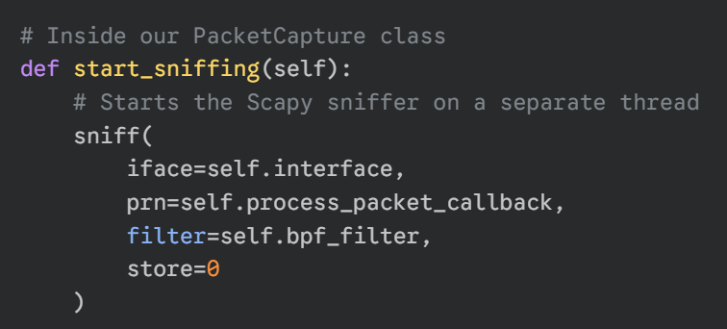
The Code: How We Capture with sniff()
The sniff() Function
Packet capture is intiated with Scapy’s sniff() function. We’ve wrapped this in our own PacketCapture class for control.
Here is a sample code that starts the capture:

Slide 16
The Code: How We Process Packets
The process_packet Callback
This is the function that Scapy calls for every packet. It’s where our main logic lives.
It follows these 4 steps:
Filter (Check for IP)
Parse (Extract Data with Scapy)
Format (Prepare for DB)
Save (Send to MongoDB)

Slide 17
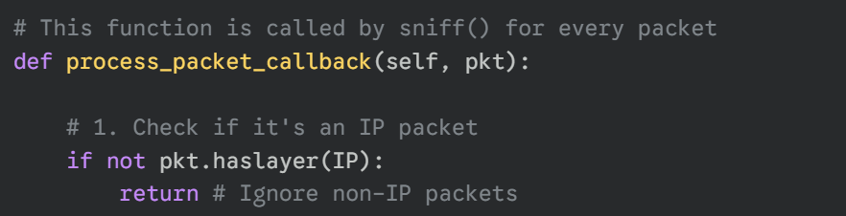
The Code: How We Process Packets
1st Step: Filter (Check for IP)
This filtering reduces unnecessary processing.
The database only stores relevant network information.

Slide 18
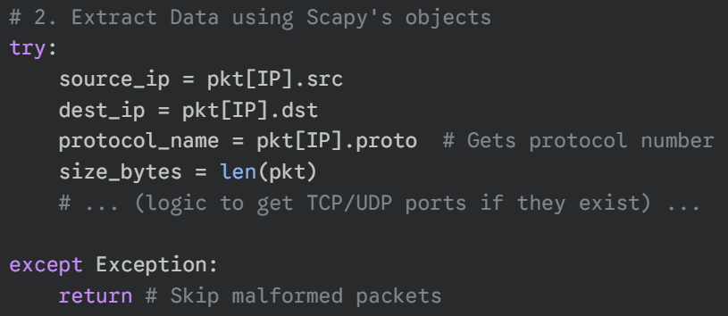
The Code: How We Process Packets
2nd Step: Parse (Extract Data with Scapy)

Slide 19
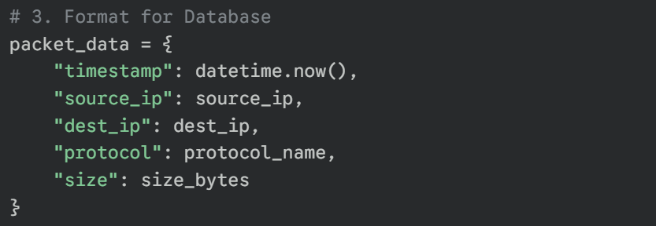
The Code: How We Process
3rd Step: Format (Prepare for DB)
4th Step: Save (Send to MongoDB)

Slide 20
Preliminaries
- MongoDB -

Slide 21

What is MongoDB?
MongoDB is a modern type of database known as a NoSQL database.
Unlike traditional databases that use tables with rows and columns (like an Excel spreadsheet), MongoDB stores in a more flexible format.
In uses JSON-like documents, which allows it to store complex data structures easily and naturally.
source
http://www.itdaily.kr/news/articleView.html?idxno=223081

Slide 22
Core Concepts: Documents & Collections
Documents
The basic unit of data in MongoDB.
A document is a set of field-and-value pairs, very similar to a JSON object.
Example: { “source_ip”: “192.168.1.10”, “protocol”: “TCP”, “size”: 64 }
Collections
A group of documents.
This is similar to a table in a traditional database.
However, a single collection can hold documents with different structures.

Slide 23
Key Advantage: Schemaless Flexibility
The most significant advantage for our project is that MongoDB is schemaless.
This means that documents within the same collection do not need to have the same fields or structure.
Why is this important for us?
Network packets are not all the same. A TCP packet has different information than a UDP packet.
MongoDB allows us to store all these different types of packets in the same packet collection without any issues.

Slide 24
Why MongoDB for Our Project?
We chose MongoDB for our traffic monitoring system for two main reasons:
High Performance
The system needs to capture and save thousands of packets per second. MongoDB is designed to handle this high volume of write operations very quickly and efficiently.
Scalability
As we capture more and more network traffic, our database will grow very large. MongoDB an easily scale across multiple servers to handle massive amounts of data without slowing down.

Slide 25
Lab Setup
github page
https://github.com/network-2025/Lab2-Wi-Fi_Traffic_Monitoring

Slide 26
Prerequisites
This lab is designed to run in a Linux-based environment (e.g., Ubuntu, etc.)
Install: python3-pip, nginx, hostapd, dnsmasq, iptables-persistent
Python: The core programming language for our capture scripts.
pip: The package installer for managing Python libraries (e.g., Scapy, Pymongo).
MongoDB: A NoSQL database used to store and query captured packet data.
Nginx: A lightweight web server for hosting the analysis dashboard.

Slide 27
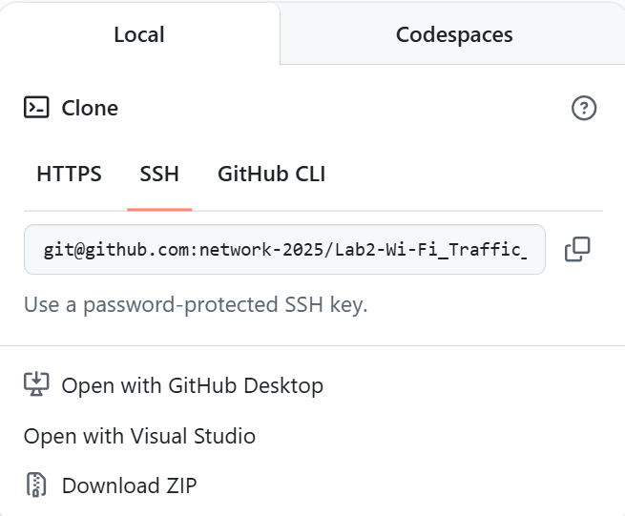
Step 0: Github Clone
github page
Clone Github Repository
git clone git@github.com:network-2025/Lab2-Wi-Fi_Traffic_Monitoring.git
source
Provided by instructor

Slide 28
Step 1: MongoDB
Import the MongoDB GPG Key
curl -fsSL https://pgp.mongodb.com/server-5.0.asc | sudo gpg -o /usr/share/keyrings/mongodb-server-5.0.gpg --dearmor
Add the MongoDB Repository
echo "deb [ arch=amd64,arm64 signed-by=/usr/share/keyrings/mongodb-server-5.0.gpg ] https://repo.mongodb.org/apt/ubuntu jammy/mongodb-org/5.0 multiverse" | sudo tee /etc/apt/sources.list.d/mongodb-org-5.0.list
source
Provided by instructor

Slide 29
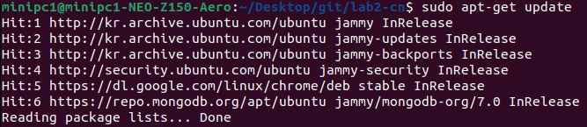
Step 2: Install
Update Local Package List
sudo apt-get update
Install All Required Packages
sudo apt-get install -y python3-pip mongodb-org nginx hostapd dnsmasq iptables-persistent
source
Provided by instructor

Slide 30
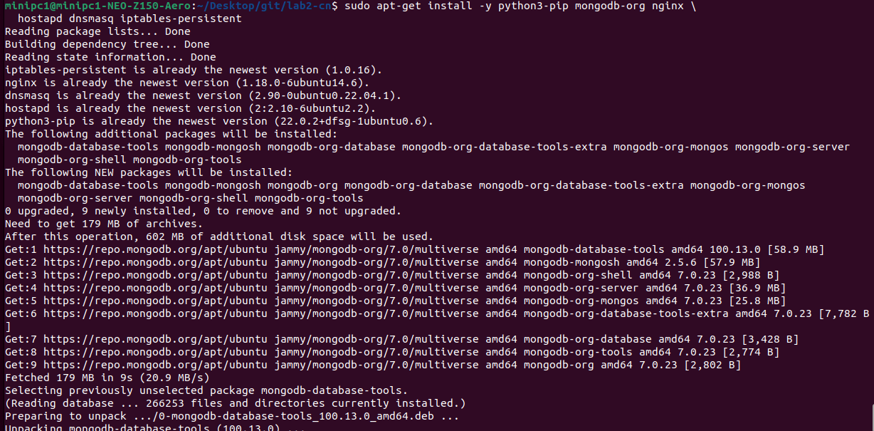
Step 2: MongoDB
source
Provided by instructor

Slide 31

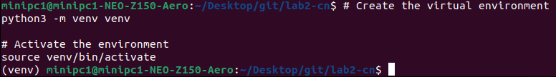
Step 3: Python Virtual Env.
Install python3-venv
sudo apt-get install -y python3-venv
Create & Activate the Environment
python3 -m venv venv
source venv/bin/activate
Virtual Env. is activated.
source
Provided by instructor

Slide 32
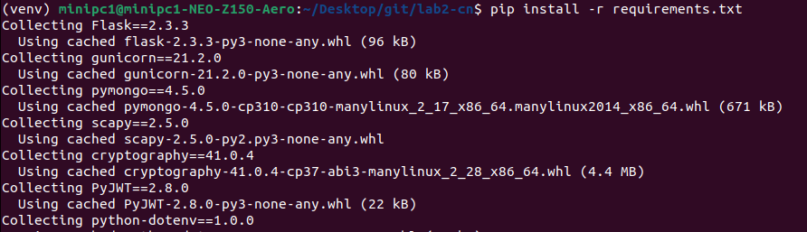
Step 3: Python Virtual Env.
With the virtual env. active, install all the required Python libraries (like Flask, Scapy, etc.) using the requirements.txt file
Install Python Dependencies
pip install -r requirements.txt
source
Provided by instructor

Slide 33

Step 4: Start & Enable MongoDB
Start and Enable the Service
sudo systemctl start mongod
sudo systemctl enable mongod
source
Provided by instructor

Slide 34
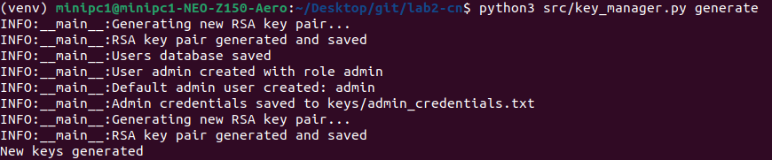
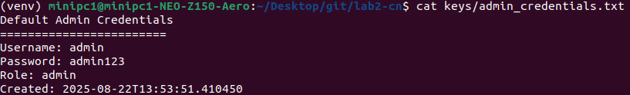
Step 5: Generate Keys
Generate Security Key & Admin Account
python3 src/key_manager.py generate
Check Password
cat keys/admin_credentials.txt
source
Provided by instructor

Slide 35
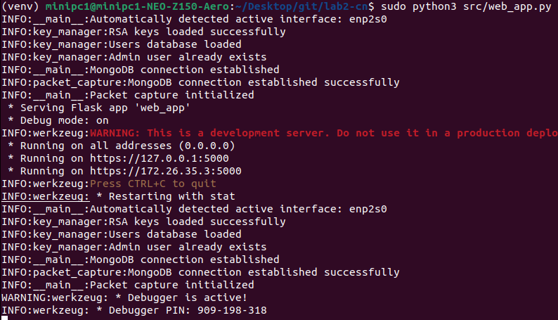
Step 6: Run Application
Run the Web Application
sudo ./venv/bin/python src/web_app.py
Ctrl+{Click}
source
Provided by instructor

Slide 36
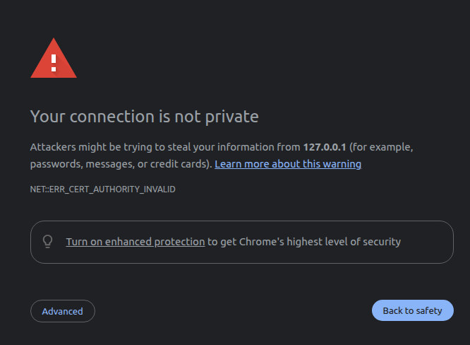
Step 6: Access to the Webpage
Run the Web Application
Click
source
Provided by instructor

Slide 37
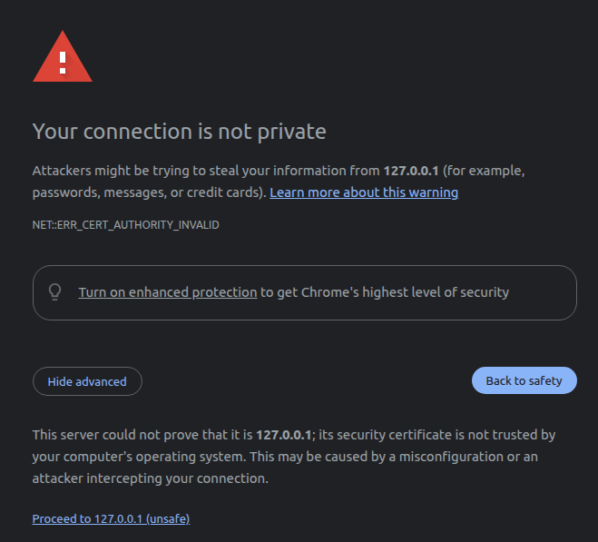
Step 6: Access to the Webpage
Click
source
Provided by instructor

Slide 38
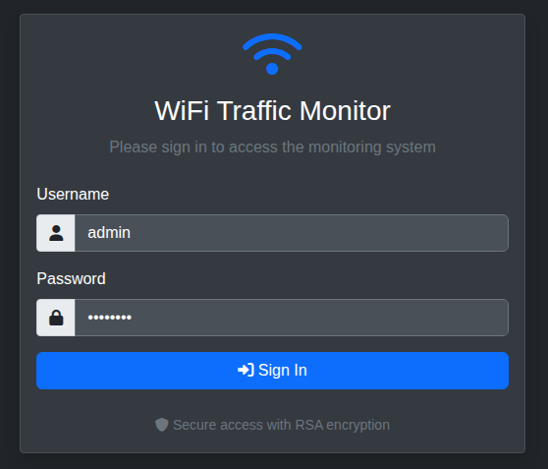
Step 6: Access to the Webpage
Log in with Username & Password
Username: admin
Password: admin123
Now, let’s dive into the detailed features of the tool and how to use them in next section.
source
Provided by instructor

Slide 39
Dashboard and Observation

Slide 40
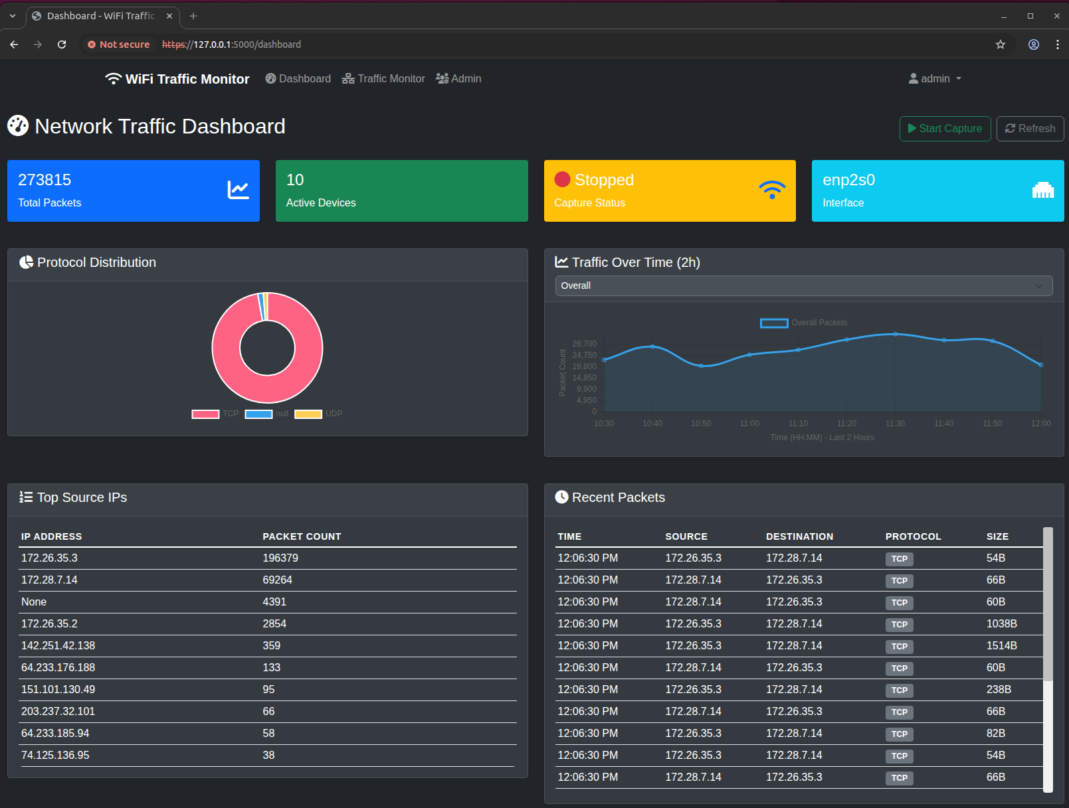
Dashboard Overview: Visualizing Network Traffic
Start Button for
Packet Capturing
Menu
Main Contents of Dashboard
source
Provided by instructor

Slide 41
Three Key Features: A Quick Tour
Dashboard
A visual summary page to understand the network’s overall status and traffic patterns at a glance through graphs and charts.
Traffic Monitor
A detailed investigation tool to troubleshoot network issues by searching and analyzing specific packets with filtering.
Admin Panel
An admin-only page to control user access and manage the system’s overall status and security.
source
Provided by instructor

Slide 42
Dashboard and Observation
- Dashboard -

Slide 43
A Snapshot of Network’s Health
The top panel offers a real-time summary of the network’s critical information
Total Packets
The cumulative count of all captured packets.
Active Devices
Shows the number of unique devices currently sending or receiving data.
Capture Status & Interface
Clearly indicates if the monitoring system is currently running (Status) and which network card (interface) is being monitored.
source
Provided by instructor

Slide 44
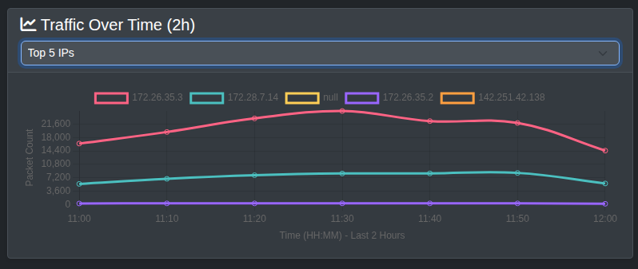
Traffic Patterns: What Kind and When?
Protocol Distribution
This donut chart shows the proportion of different protocols, like TCP and UDP.
It helps you understand the primary purpose of the network’s usage, whether it’s for web browsing (TCP) or for video streaming and gaming (UDP).
Traffic Over Time
This line graph displays the trend of traffic volume over a specific period.
It’s essential for identifying the network’s busiest periods and spotting anomalies, such as sudden and unexpected traffic spikes.
source
Provided by instructor

Slide 45
Detailed Analysis: Who is Talking and What Are They Saying?
Top Source Ips
This table ranks the IP addresses that have generated the most packets on the network.
It allows you to identify which devices are consuming the most bandwidth.
Recent Packets
A real-time log of captured packets, displayed chronologically with details like source, destination, protocol, and size.
This provides the most granular and specific data.
source
Provided by instructor

Slide 46
Dashboard and Observation
- Traffic Monitor -

Slide 47
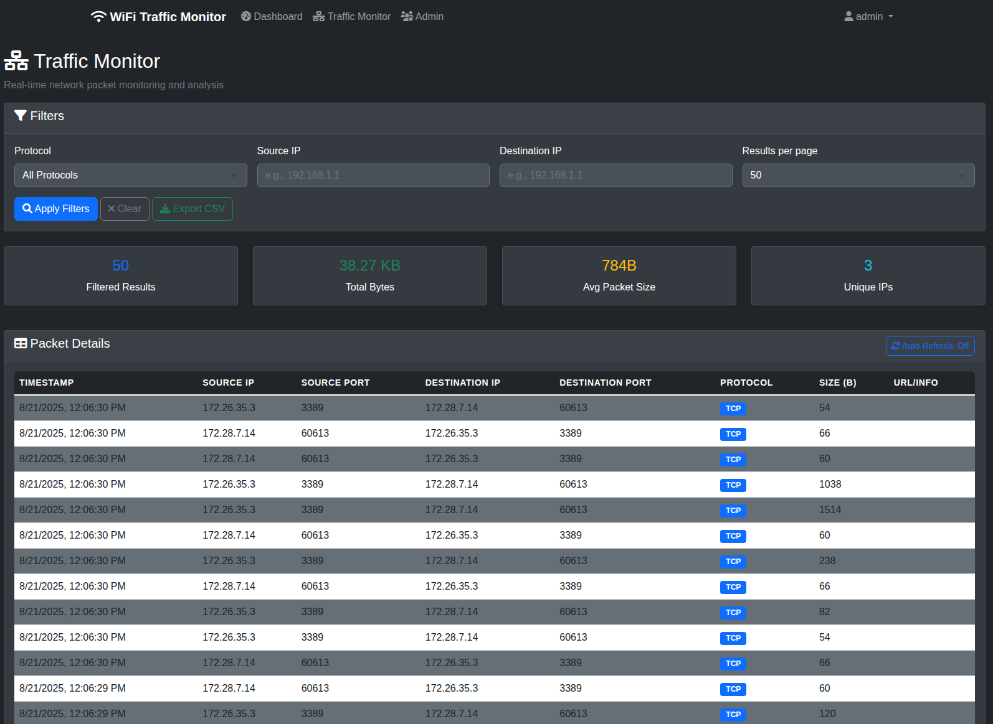
Traffic Monitor: Deep Packet Inspection
The Traffic Monitor page is an interactive tool for detailed, real-time analysis of captured packets.
Unlike the main dashboard which provides a summary, this view allows you to filter, search, and drill down into specific network conversations for in-depth investigation and troubleshooting.
source
Provided by instructor

Slide 48
Traffic Monitor: Deep Packet Inspection
Filters
Allows you to pinpoint specific data flows.
You can search by Protocol, Source IP, and Destination IP.
Exporting
Enables offline analysis and reporting.
The “Export CSV” feature allows you to save your filtered results, making it easy to share data or perform further analysis in other tools like Excel.
source
Provided by instructor

Slide 49
Dashboard and Observation
- Admin Panel -

Slide 50
This slide is containing the same contents with the slide no. 52.
Please check them and correct them.
Traffic Monitor: Deep Packet Inspection
The Traffic Monitor page is an interactive tool for detailed, real-time analysis of captured packets.
Unlike the main dashboard which provides a summary, this view allows you to filter, search, and drill down into specific network conversations for in-depth investigation and troubleshooting.
source
Provided by instructor

Slide 51
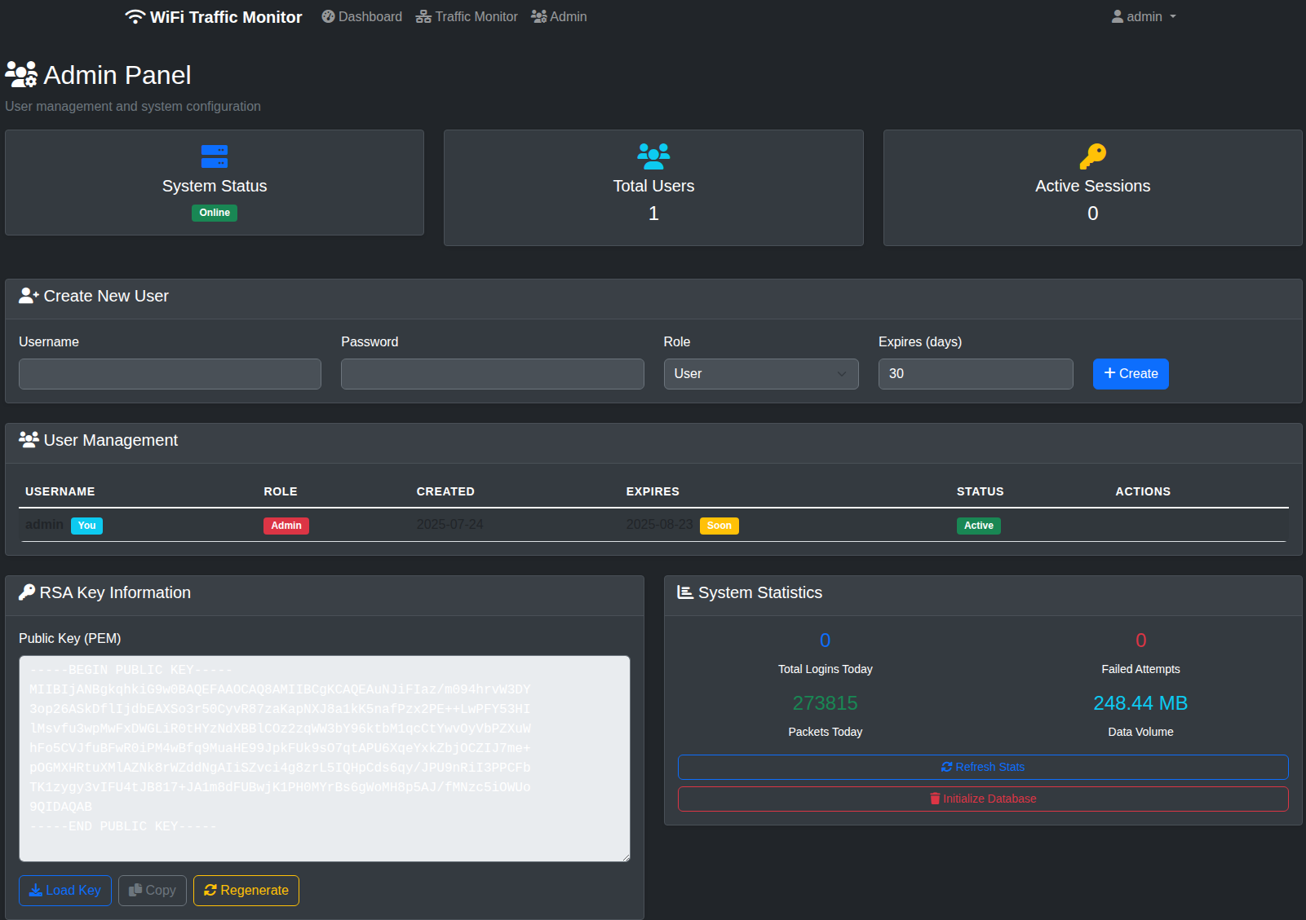
Admin Panel System & User Management
The Admin Panel is the central hub for system configuration and security, separate from the traffic analysis dashboard.
source
Provided by instructor

Slide 52
Traffic Monitor: Deep Packet Inspection
Create New User
Allows the administrator to create new user accounts.
You can define a Username, Password, assign a Role and set an expiration date for the account.
User Management Table
Provides a comprehensive list of all existing users.
source
Provided by instructor

Slide 53
Traffic Monitor: Deep Packet Inspection
RSA Key Information
Manages the public key for secure communication.
This is an advanced security feature, likely used to secure API connections or ensure encrypted communication between monitoring components.
System Statistics
Offer a high-level overview of the system’s health.
You can quickly see the online status and statistics of the system.
You can also initialize the database.
source
Provided by instructor

Slide 54
Advanced Suggestion
Intelligent Network Monitoring

Slide 55

Future Enhancements: Intelligent Network Monitoring with AI & LLM
Our current system provides a robust foundation for advanced network analysis.
By integrating AI and Large Language Models (LLMs), we can unlock powerful new capabilities.
Intelligent Threat Detection
Predictive Network Management
Anomaly Detection
Proactive Defense
Bandwidth Prediction
Automated Troubleshooting
Content-Based Filtering & Blocking
Enhanced Network Insights & Reporting
Harmful Website Detection
Time-Based Access Control
User Behavior Analysis
Natural Language Reporting

